Slide 1
Assignment based Subjective Questions

Slide 2
From your analysis of the categorical variables from the dataset, what could you infer about their effect on the dependent variable?

Slide 3
Why is it important to use drop_first=True during dummy variable creation?
The parameter drop_first=True is used to prevent multicollinearity in regression models.
The dummy variable trap occurs when the dummy variables created for a categorical variable are highly correlated, leading to problems in the estimation and interpretation of regression coefficients. By setting drop_first=True, we can automatically exclude one of the dummy variables for each categorical variable, eliminating the trap.

Slide 4
General Subjective Questions

Slide 5
1. Explain the linear regression algorithm in detail.

Slide 6
2. Explain the Anscombe’s quartet in detail.
Anscombe’s quartet is a set of four dataset that have identical descriptive statistical properties in terms of means, variance, R-Squared, correlations and linear regression lines but having different representations when we scatter plot on graph. Each dataset consists of eleven (x, y) points. The datasets were created to demonstrate the importance of visualizing data and to show that summary statistics alone can be misleading.
Anscombe’s quartet is used to illustrate the importance of exploratory data analysis and the drawbacks of depending only on summary statistics. It also emphasizes the importance of using data visualization to spot trends, outliers, and other crucial details that might not be obvious from summary statistics alone.

Slide 7
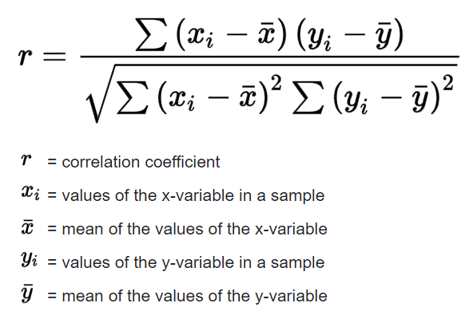
3. What is Pearson’s R?
The Pearson correlation coefficient is a descriptive statistic, meaning that it summarizes the characteristics of a dataset. Specifically, it describes the strength and direction of the linear relationship between two quantitative variables.
It is a number between –1 and 1 with +1 representing a positive correlation, -1 representing a negative correlation, and 0 representing no relationship. When one variable changes, the other variable changes in the same direction.
It can be represented by the formula:

Slide 8
4. What is scaling? Why is scaling performed? What is the difference between normalized scaling and standardized scaling?
Scaling is a step of data Pre-Processing which is applied to independent variables to normalize the data within a particular range. It also helps in speeding up the calculations in an algorithm.
Most of the times, collected data set contains features highly varying in magnitudes, units and range. If scaling is not done then algorithm only takes magnitude in account and not units hence incorrect modelling. To solve this issue, we have to do scaling to bring all the variables to the same level of magnitude.
It is important to note that scaling just affects the coefficients and none of the other parameters like t-statistic, F-statistic, p-values, R-squared, etc.

Slide 9
Normalized Scaling:
It brings all the data in the range of 0 and 1. sklearn.preprocessing.MinMaxScaler helps to implement normalization in python.
Normalized Scaling(x) = (x - min(x))/(max(x) – min(x))
Standardization Scaling:
Standardization replaces the values by their Z scores. It brings all the data into a standard normal distribution which has mean (μ) zero and standard deviation one (σ).
Normalized Scaling(x) = (x - mean(x))/sd(x)

Slide 10
Normalized Scaling | Standardization Scaling
Normalized scaling is helpful when the feature distribution is unclear, and data's distribution does not match a Gaussian distribution. A practical transformation approach that helps the model perform and be more accurate is normalization. | Standardization Scaling is helpful when feature distribution is consistent and you are entirely aware of the feature distribution of your data or when your data has a Gaussian distribution.
Normalized scaling additionally known as scaling normalization, values on the scale fall between [0, 1] and [-1, 1]. | Standardization Scaling is called Z-score normalization, values on a scale are not constrained to a particular range.
This method scales the model using minimum and maximum values. | This method scales the model using the mean and standard deviation.
When features are on various scales, it is functional. | When a variable's mean and standard deviation are both set to 0, it is beneficial.

Slide 11
1. You might have observed that sometimes the value of VIF is infinite. Why does this happen?

